Slide 1
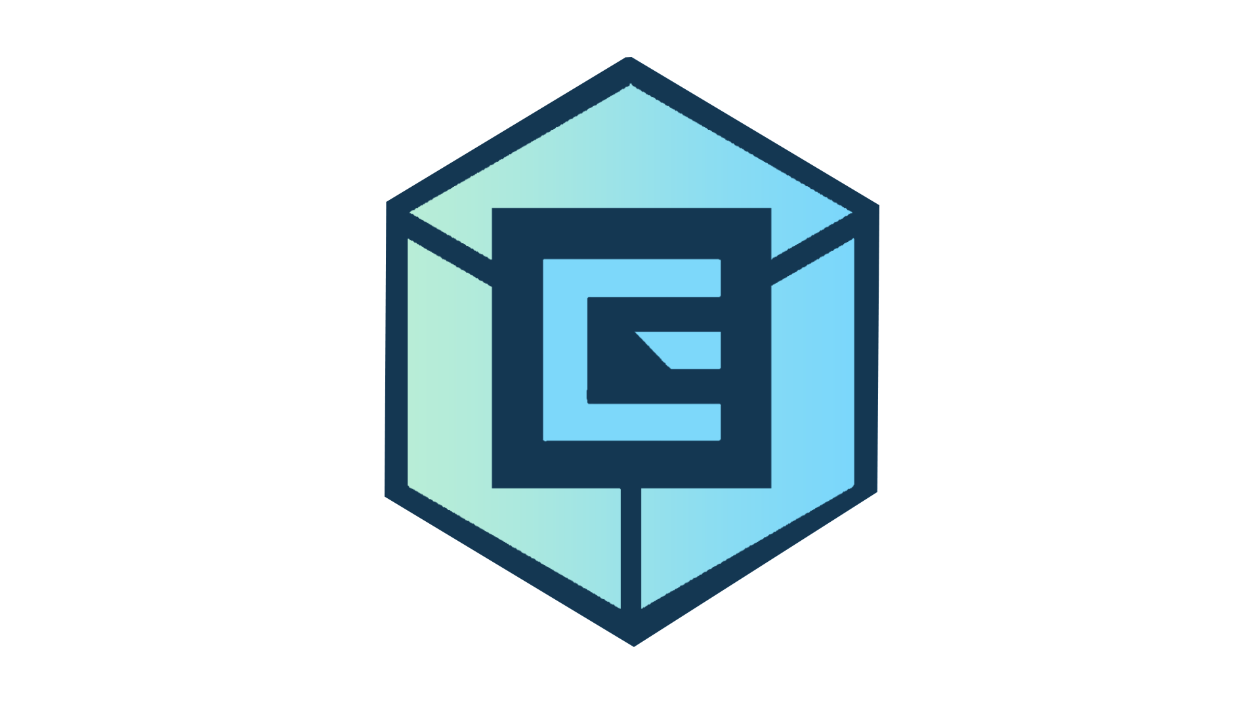
A Journey to Production
Ts. Ammar Abdullah

Slide 2

About Me
Ts. Ammar Abdullah
Expertise area - Blockchain (Hyperledger & Ethereum), machine learning , IoT, full stack software development, cloud solution
Bachelor & Master in Engineering at Korea University
Currently pursuing part time PhD at UTM
Samsung Electronics, Korea - Asic Design Engineer - ASIC Chip Design
Funai R&D Malaysia - Assistance Chief Engineer - Embedded Software
OK Blockchain - R&D Manager - Blockchain, AI, Big data, IoT, Cloud, Full stack
Smart Tradzt - Innovation Lead - Blockchain, Machine Learning, Cloud, IoT, Full stack
Ever AI Technologies – CTO
https://www.linkedin.com/in/ammarabd/

Slide 3
Our Target Today
Understanding how the actual development flow is done in the industry from development to production
Understanding how to design proper software architecture
Understanding how to write proper code structure which cater most of the requirements
Understanding the proper setup for production and how continuous integration can be automated

Slide 4

So, to get solid understanding…
Let’s do more
hands on today !!

Slide 5
Software Development Life Cycle
Planning
Designing
Development
Requirement
Analysis
Testing
Maintenance
Deployment

Slide 6
Software Development Environment
Development
Staging
Production
class DevConfig(BaseConfig):
FLASK_ENV = 'development'
DEBUG = True
DBNAME = 'DBNAME_DEV'
SQLALCHEMY_DATABASE_URI = DATABASE_URI
SQLALCHEMY_TRACK_MODIFICATIONS = True
SWAGGER = {
'title': 'Development App',
}
class StagingConfig(BaseConfig):
FLASK_ENV = 'staging'
DEBUG = False
DBNAME = 'DBNAME_STAGE'
SQLALCHEMY_DATABASE_URI = DATABASE_URI
SQLALCHEMY_TRACK_MODIFICATIONS = True
SWAGGER = {
'title': Staging App',
}
class ProdConfig(BaseConfig):
FLASK_ENV = 'production'
DEBUG = False
DBNAME = 'DBNAME'
SQLALCHEMY_DATABASE_URI = DATABASE_URI
SQLALCHEMY_TRACK_MODIFICATIONS = True
SWAGGER = {
'title': Production App',
}

Slide 7
Important Elements In SW Management
Development
Methodology
Task Management Board
CICD
Repository
Agile
Waterfall
etc
Jira
Redmine
Notion
Clickup
Gitscrum
Jenkins
Travis
Circle
Bamboo
Git
SVN
TFS
IDE
VS code
Intellij IDEA
Pycharm

Slide 8
Important Elements In SW Development
Frontend Framework
Backend Framework
Database
Unit Test Framework
ReactJS
NextJS
VueJS
Angular
Django
etc
NodeJS
Spring Boot
Flask
Django
Symfony
etc
MySQL
Postgresql
Mongodb
Couchdb
etc
Chai
Mocha
Jasmine
Pytest
etc
MVC
MVVP
Flux
Redux
Code Structure

Slide 9
Important Elements In Production
Deployment
Production
Server
Scalability
Security
Kubernetes
Managed Kubernetes
AWS ECS
Docker Swarm
AWS
GCP
Azure
On Premise
Load balancer
Response time
Multi processing
Auto scaling
AWS VPC
Subnetting
Access Control
Open port

Slide 10
Let’s Setup Our GIT Repository

Slide 11
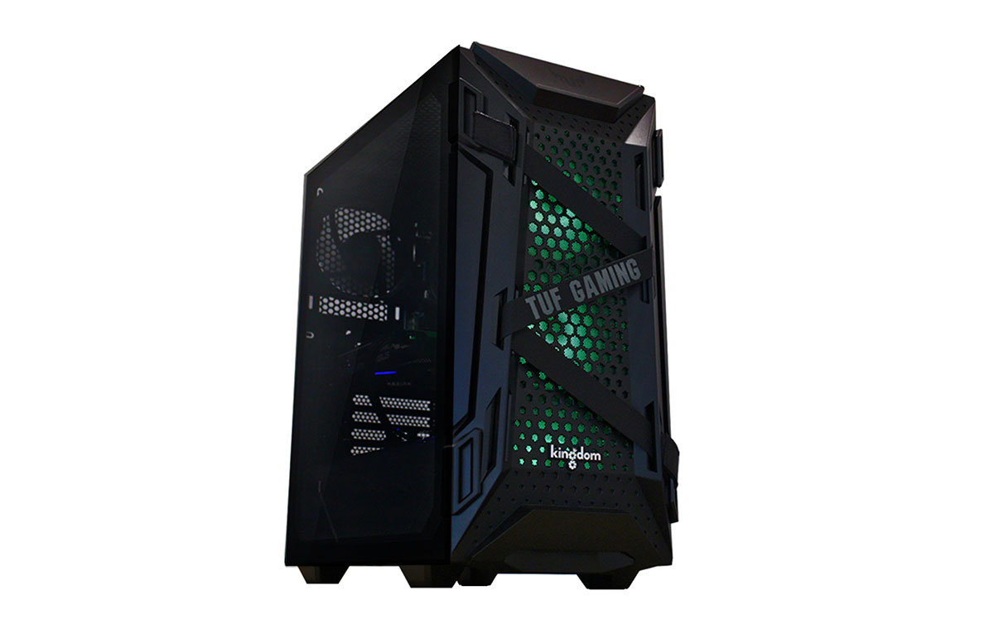

How to manage Git branch ?
Master
Develop
Feature
Release
Hotfix
Remote (Github / Gitlab / Bitbucket / etc)
Local PC
https://www.atlassian.com/git/tutorials/comparing-workflows/gitflow-workflow#:~:text=Gitflow%20is%20a%20legacy%20Git,software%20development%20and%20DevOps%20practices.

Slide 12
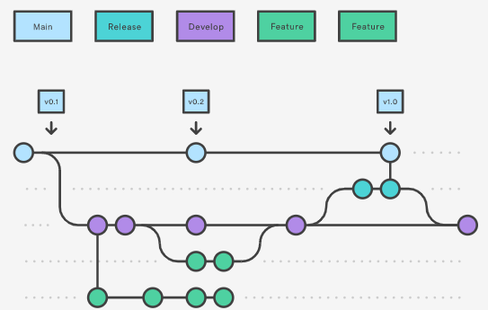
How to manage Git branch ?
https://www.atlassian.com/git/tutorials/comparing-workflows/gitflow-workflow#:~:text=Gitflow%20is%20a%20legacy%20Git,software%20development%20and%20DevOps%20practices.

Slide 13
How to merge between Git branch ?
Master
Develop
Need pull request ?
Develop
Pull Request
Feature A
Merge To Master
Need pull request ?
Pull Request
Release v1
Merge To Develop
Use case for developer to
merge feature branch
Use case for developer to
merge to release branch

Slide 14
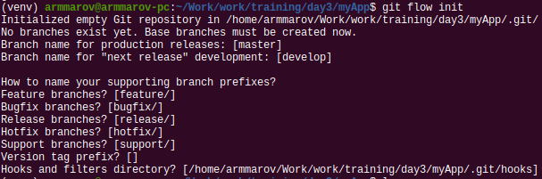
How to start with Git Flow
# git flow init
# git branch

Slide 15
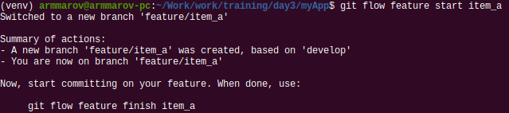
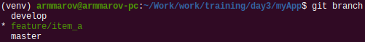
How to create feature branch ?
# git flow feature start <feature-name>
# git branch

Slide 16
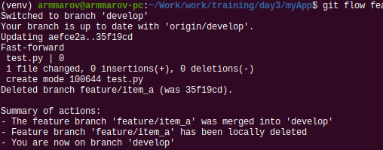
How to finish feature branch w/o pull request ?
# git add .
# git commit -m “Add new file”
# git flow feature finish <feature-name>
# git branch

Slide 17
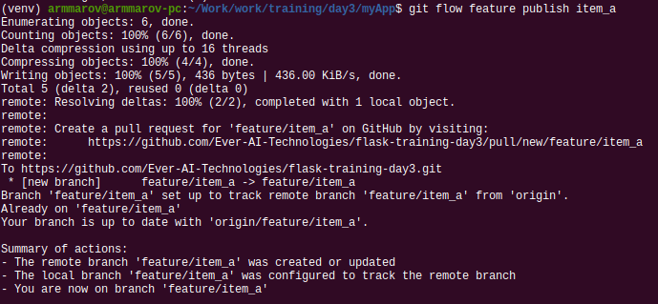
How to create pull request ?
# git add .
# git commit -m “Add new file”
# git flow feature publish <feature-name>
# git branch

Slide 18
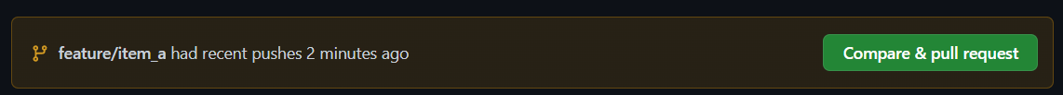
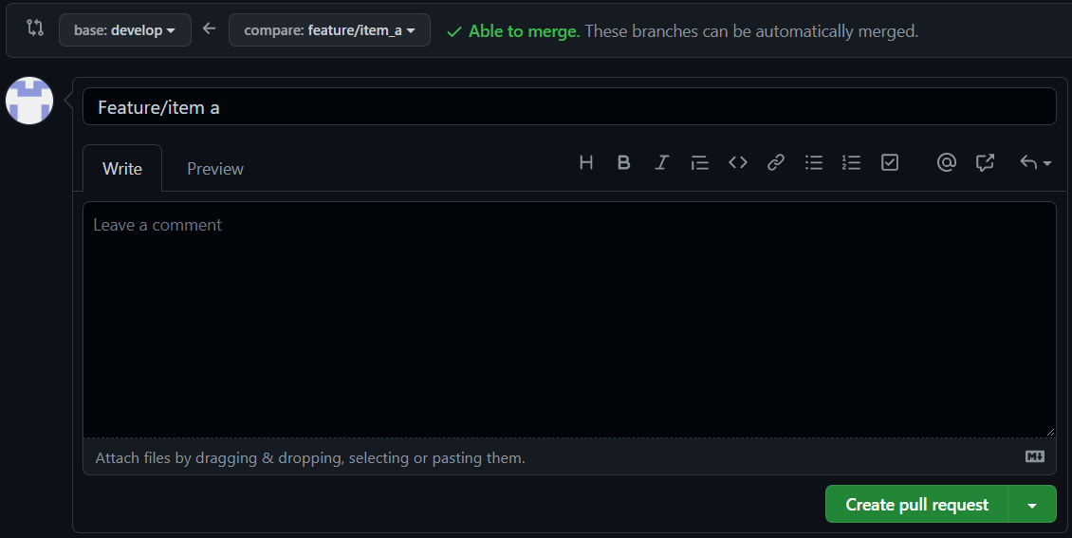
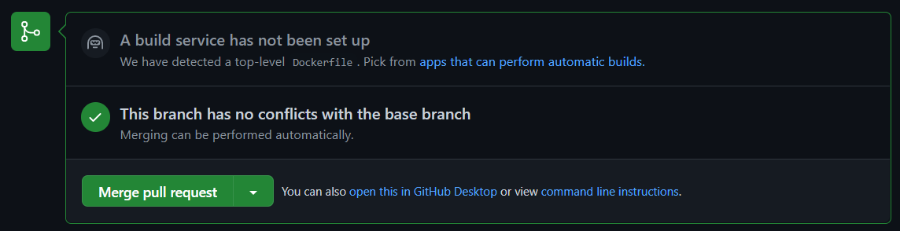
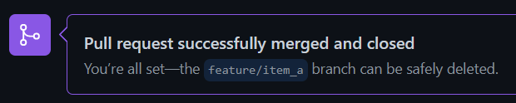
How to create and merge pull request ?
1
2
3
4

Slide 19
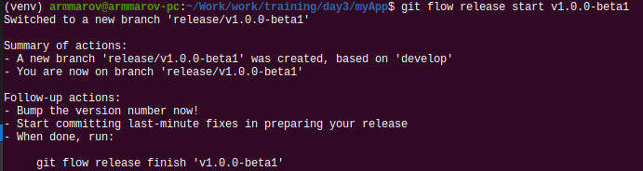
How to create and publish release branch ?
# git flow release start <release-version>
# git flow release publish <release-version>

Slide 20
Let’s restructure our codes

Slide 21

Designing Software Architecture
Main Server
Config
Data Model
ML Model
Routing
Services
3rd Vendors
Controller
Utils
Unit test

Slide 22
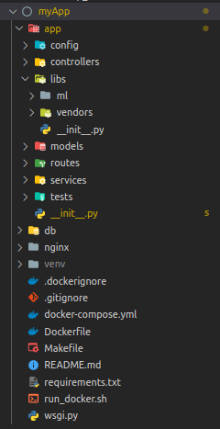
How the structure looks like ?
app/__init__.py
app/services/*.py
app/models/*.py
app/routes/*.py
app/libs
app/controllers/*.py
app/utils/*.py

Slide 23
Let us look into the codes deeper
https://github.com/armmarov/journey-to-production.git

Slide 24


Please do me a favour ^^
Create an API with the endpoint “POST /add-me”, and the following json data
{ a: 4, b: 5 }
The function should be able to compute a + b and return me a value
Please do pull request, and i will merge and let others test your function

Slide 25
Let’s Design Our Production
Architecture

Slide 26
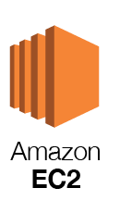


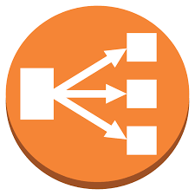

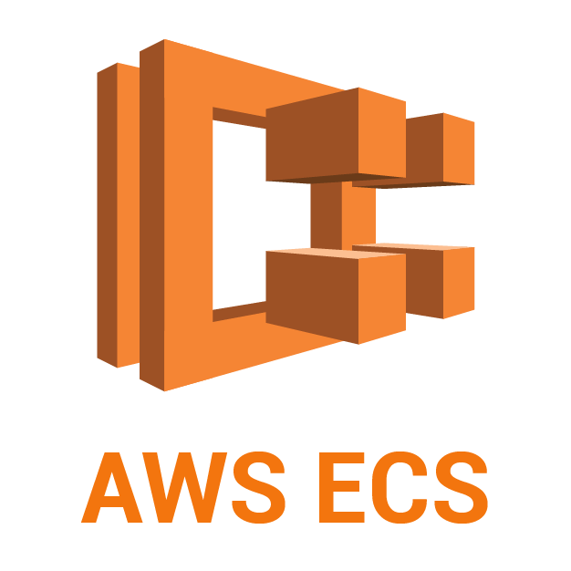
Designing Production Architecture
DNS,
SSL
LB
ML Model

Slide 27
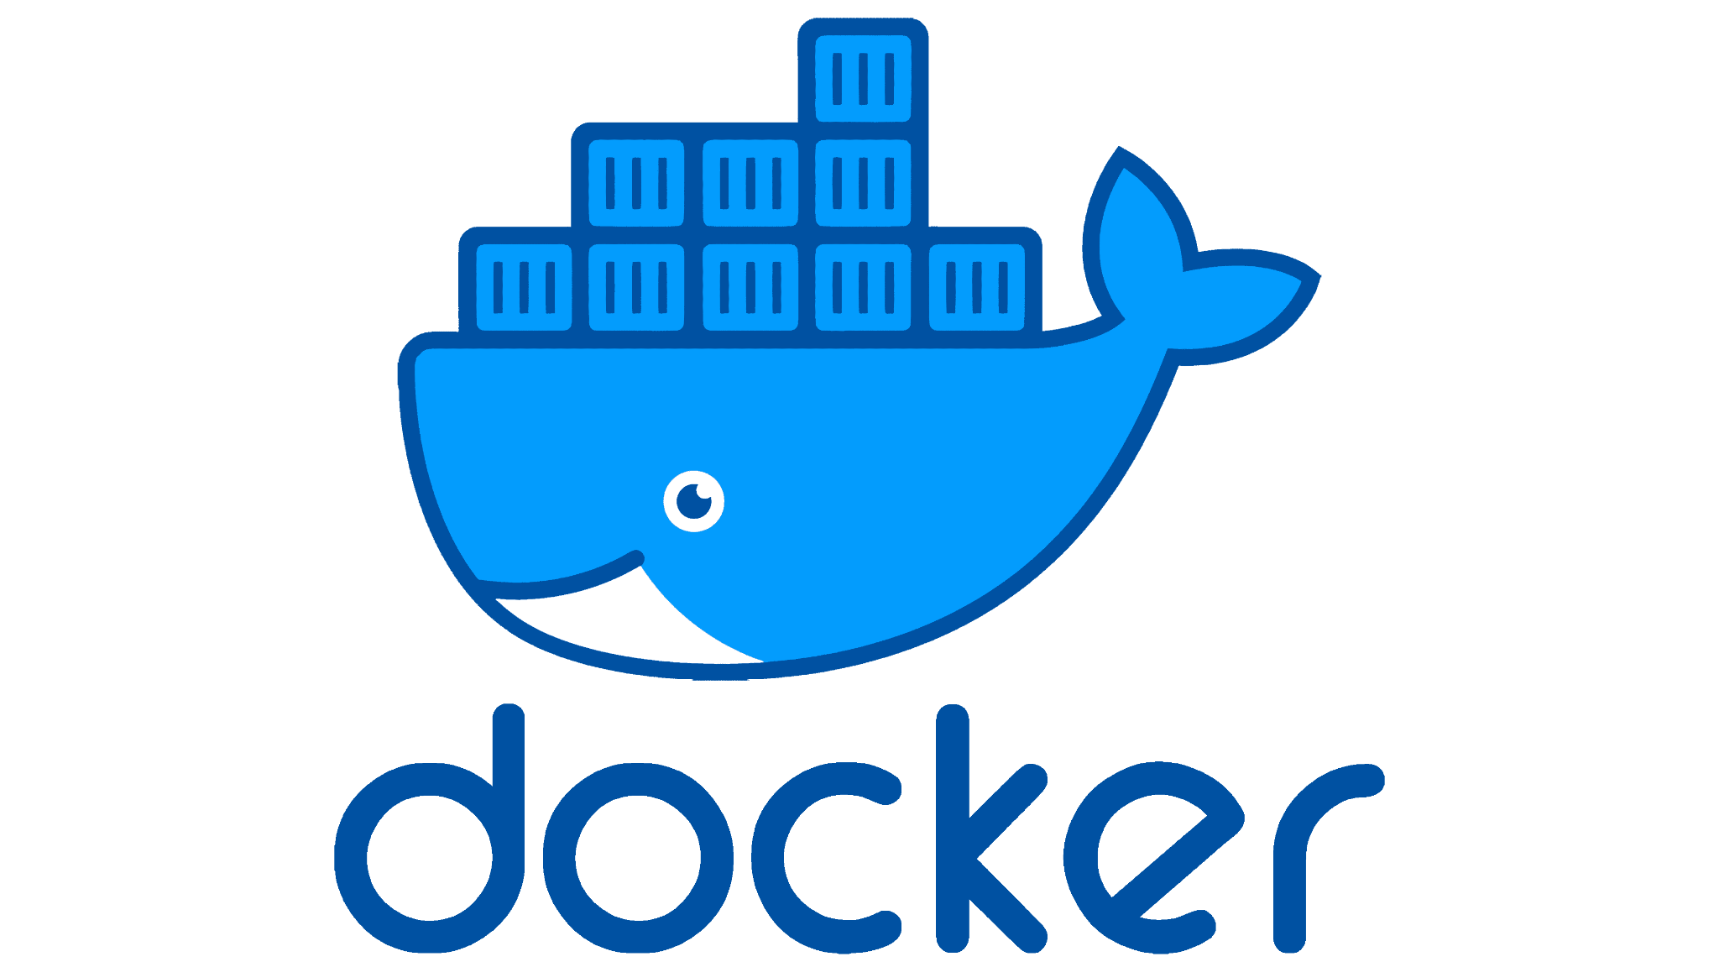
How to set the whole architecture up ?
Thanks to this WHALE !!!

Slide 28
But wait, what is the Containerization in the first place ?
App 1
App 1
App 1
Bins / Libs
Bins / Libs
Bins / Libs
App 1
App 1
App 1
Virtual Machine
Container (Docker)
Guest OS
Guest OS
Guest OS
Bins / Libs
Bins / Libs
Bins / Libs
Hypervisor
Docker Engine
Host OS
Host OS (Linux)

Slide 29
What is the important components for Docker ?
Docker Registry (DockerHub, ECR)
push
pull
run
Docker Image
Docker Container
Docker Network
build
Docker Volume
Source Code + Dockerfile
View logs
Access docker

Slide 30
How to use Docker command line ?
Docker Image
> docker pull <image_name:version> # Pull docker image from docker registry
> docker build . # Build docker image from source code
> docker images # View docker image list
> docker rmi <image_name> # Remove docker image
Docker Container
> docker run -d -p <local_port>:<container_port> <image> # Run docker container
> docker ps # View running container
https://docs.docker.com/engine/reference/commandline/docker/

Slide 31
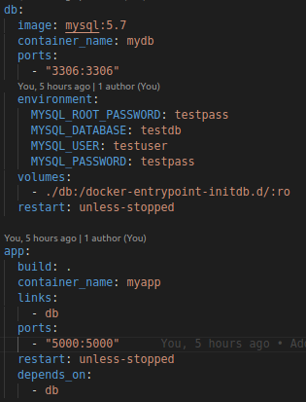
How to run and manage Docker container simultaneously ?
Image 1
Container 1
Image 2
Docker compose
Container 2
Image 3
Container 3
docker-compose.yml

Slide 32

Back to our previous production architecture, let’s try to build docker container for all components that we have together
Docker Container 1 : Webserver
Docker Container 2 : Our application
Docker Container 3 : Database

Slide 33
Continuous Integration
Continuous Deployment (CICD)

Slide 34


Why we need CICD ?
AUTOMATION to make our life more PRODUCTIVE
Continuous
Integration
Auto build
Auto test
Auto push to registry
Auto deploy
Continuous
Deployment
Development
Production

Slide 35
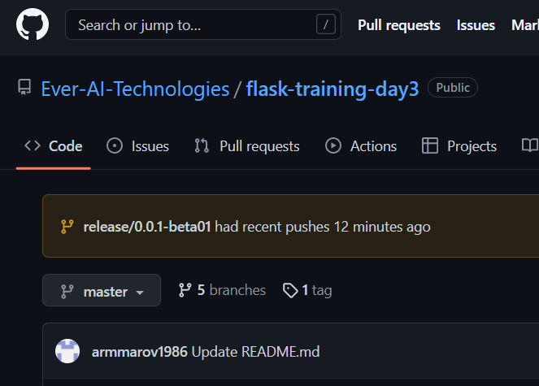
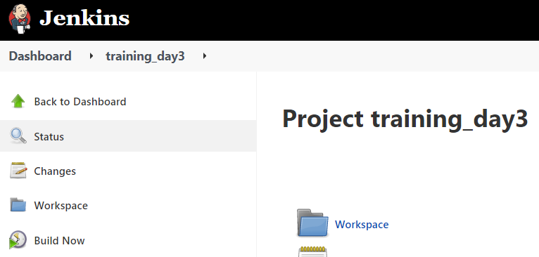
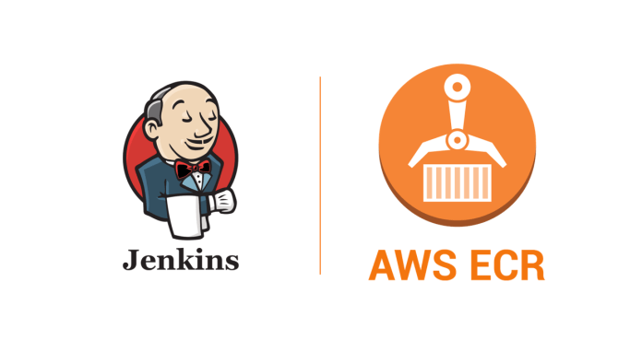
How we can automate CI part ?
Source Control (Github)
CICD Tool (Jenkins)
Docker Registry (ECR)
Webhook
Push
Clone
Build
Test
Push
Receive event (push)
Deploy to ECS/VPS

Slide 36
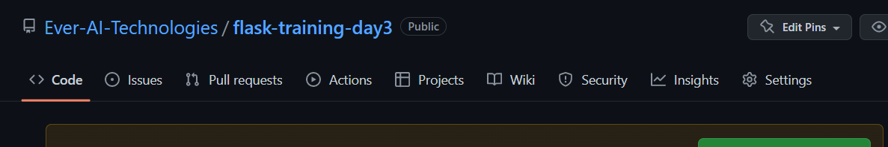
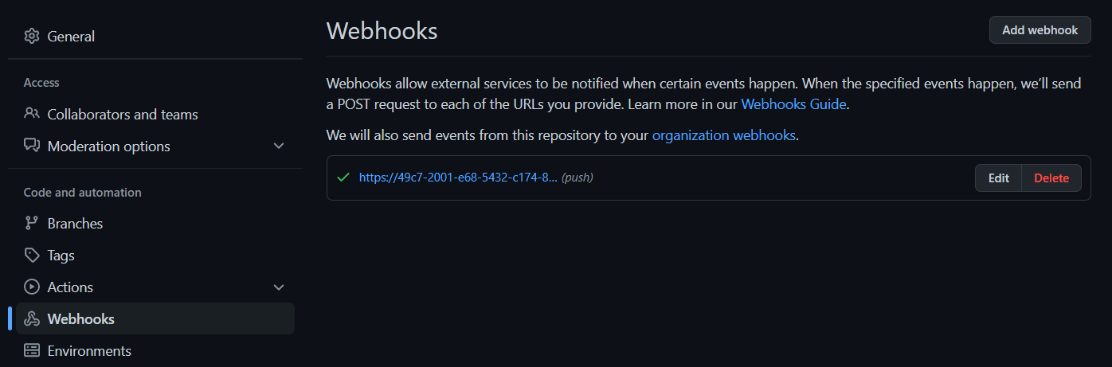
How to set Github for webhook ?
1
3
2

Slide 37
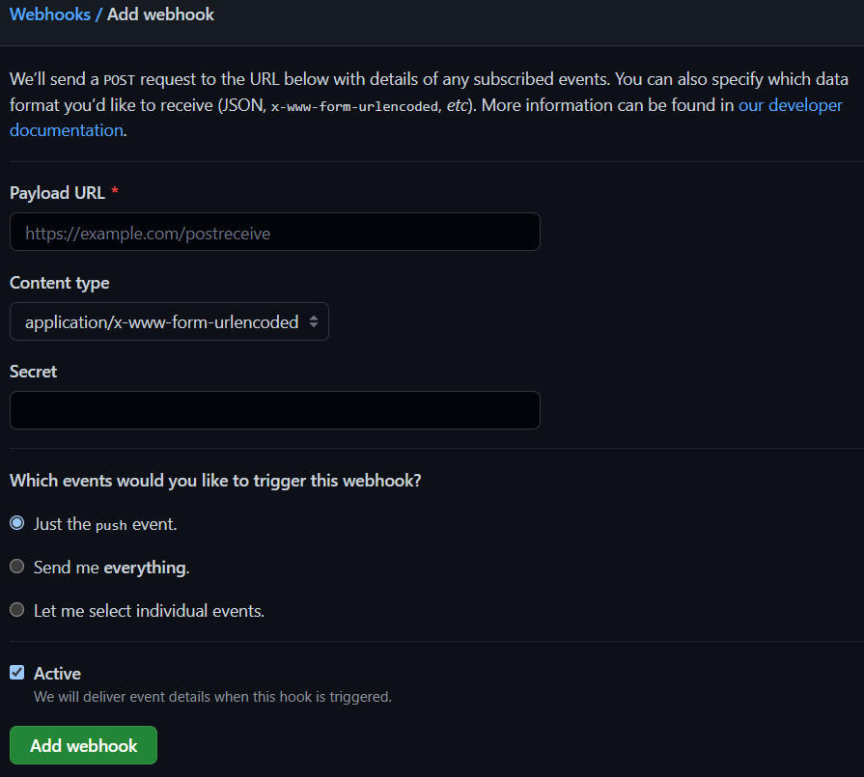
How to set Github for webhook ?
Add jenkins URL
https://jenkins_url:jenkins_port/github-webhook/
Add secret key for more secure
Select webhook trigger event

Slide 38
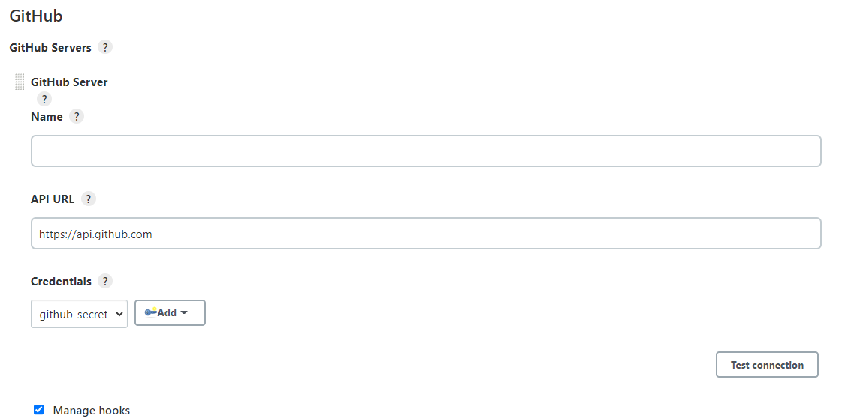
How to set Github Server in Jenkins for webhook ?
Open Manage Jenkins
Open Configure System
Add credential for Github Server
Click Test connection button
Tick Manage hooks

Slide 39
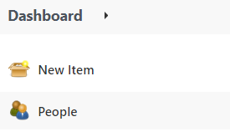
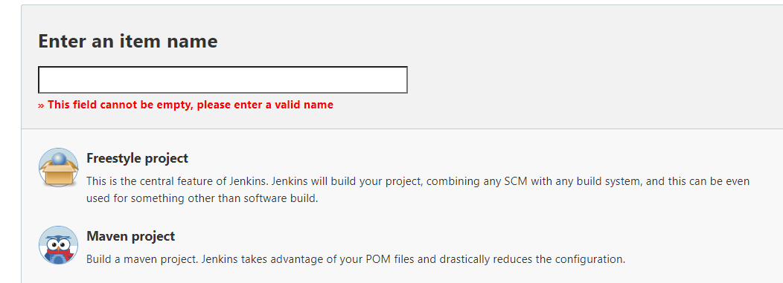
How to set up Jenkins project ?
At the dashboard, click New Item
Enter the project name, select “Freestyle project”

Slide 40
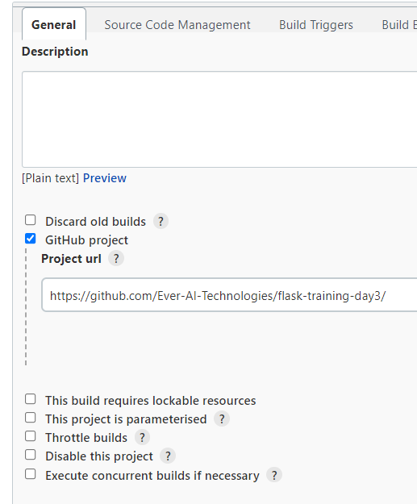
How to set up Jenkins project ?
At the General Tab, tick the Github project, fill in the github url

Slide 41
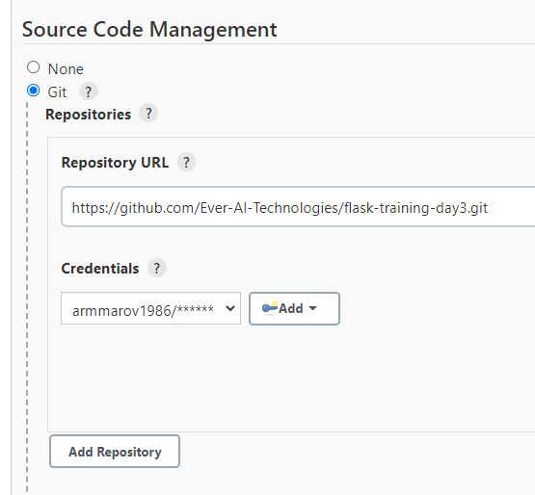
How to set up Jenkins project ?
Scroll down to Source Code Management, tick Git and fill in Repository URL and credential

Slide 42
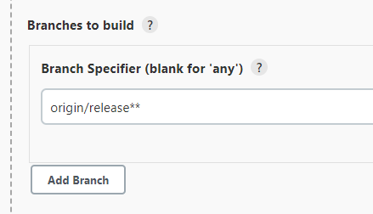
How to set up Jenkins project ?
Set branch to only origin/release** to allow only release branch, otherwise leave it blank to allow all branches

Slide 43
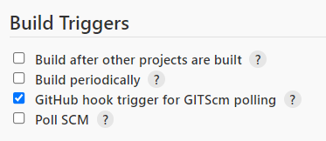
How to set up Jenkins project ?
Scroll to Build Triggers, tick the selection for Github hook trigger for GITScm polling
This will activate the webhook from Github

Slide 44
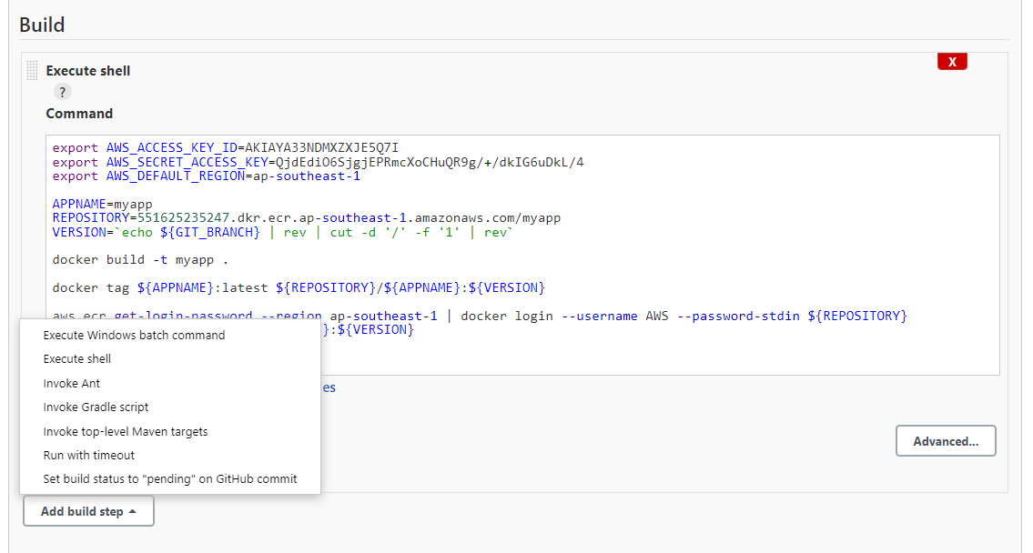
How to set up Jenkins project ?
Scroll down to the Build section, click Add build step, select Execute shell.
Command window will appear

Slide 45
How to set up Jenkins project ?
Copy paste this command into the Command window and Save
export AWS_ACCESS_KEY_ID=<YOUR_ACCESS_KEY>
export AWS_SECRET_ACCESS_KEY=<YOUR_SECRET_KEY>
export AWS_DEFAULT_REGION=ap-southeast-1
APPNAME=myapp
REPOSITORY=<YOUR_DOCKER_REPOSITORY>
VERSION=`echo ${GIT_BRANCH} | rev | cut -d '/' -f '1' | rev`
docker build -t ${APPNAME} .
docker tag ${APPNAME}:latest ${REPOSITORY}/${APPNAME}:${VERSION}
aws ecr get-login-password --region ap-southeast-1 | docker login --username AWS --password-stdin ${REPOSITORY}
docker push ${REPOSITORY}/${APPNAME}:${VERSION}

Slide 46

So now how can we execute all this ?
Hints
Branch must be a release branch
Trigger event is set to “push”
Is it working well now ? Or are we still missing something ?

Slide 47
Docker Registry

Slide 48
What is ECR ?
AWS managed container image registry service that is secure, scalable and reliable.
Support private / public repositories
Pull
ECS
Build
Push
Source code
Docker Image
at Local PC
ECR
VPS
Pull

Slide 49
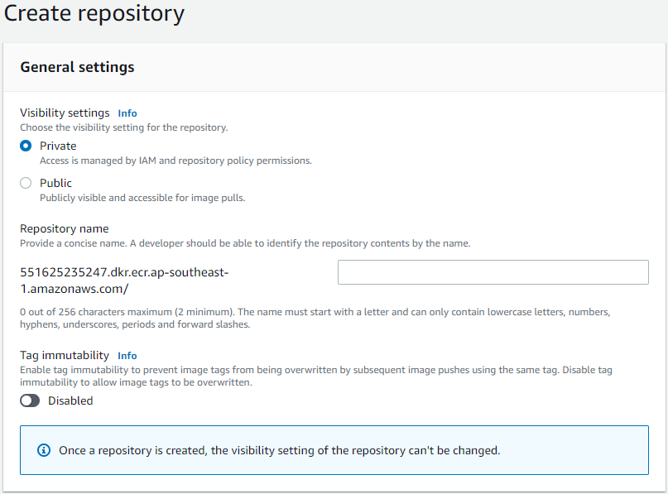
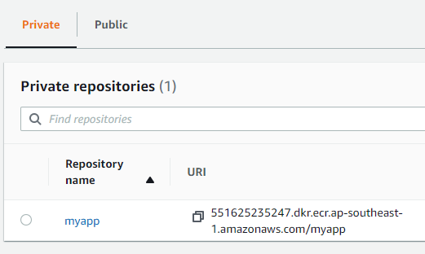
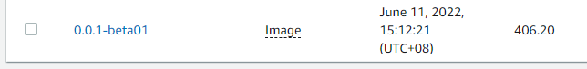
How to create registry repository ?
Navigate to https://ap-southeast-1.console.aws.amazon.com/ecr/get-started?region=ap-southeast-1
View Repository
Add Repository
Add repo name here
View Docker Image

Slide 50
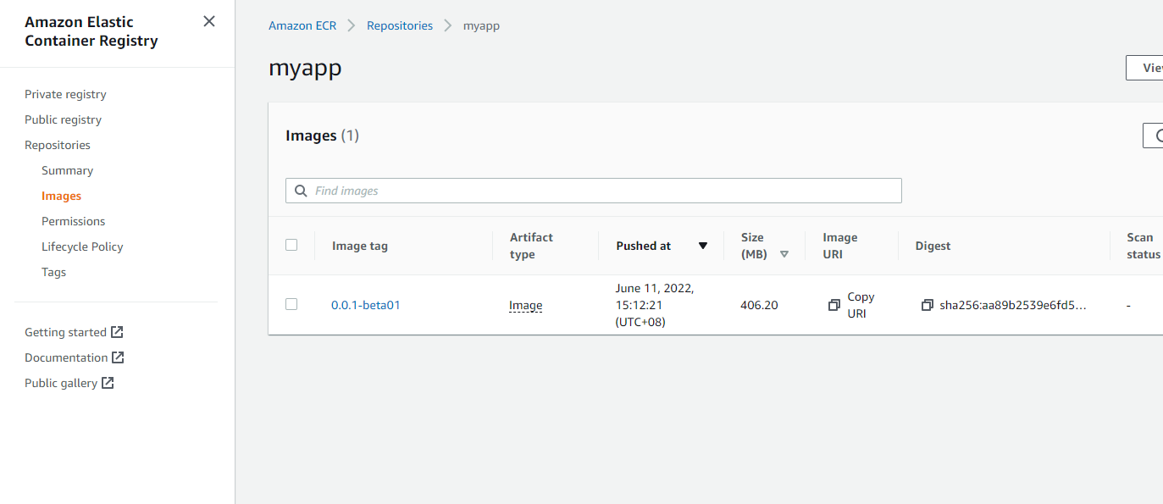
Now, let’s try again and see if it works !!
Our target is to see this image in our list

Slide 51
Let’s properly set up our AWS for Production

Slide 52
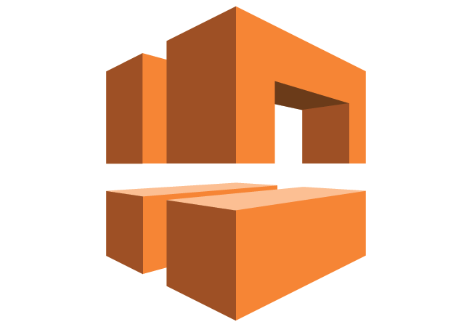


Before we jump in, let’s set up the network first
VPC
Internet
Gateway
Public subnet
Private subnet
NAT Gateway

Slide 53
Let’s see step by step
IPv4 CIDR
172.31.0.0/20
172.31.16.0/20
172.31.32.0/20
Route to IG
Add public subnets
IG
Public Subnet
Public Route Table
VPC
Default
Default
Default
1
2
3
Default
NAT
Private Subnet
Private Route Table
Point to public subnet
Set connectivity to Public to allow outbound connection
IPv4 CIDR
172.31.48.0/20
172.31.64.0/20
172.31.80.0/20
Route to NAT
Add private subnets

Slide 54
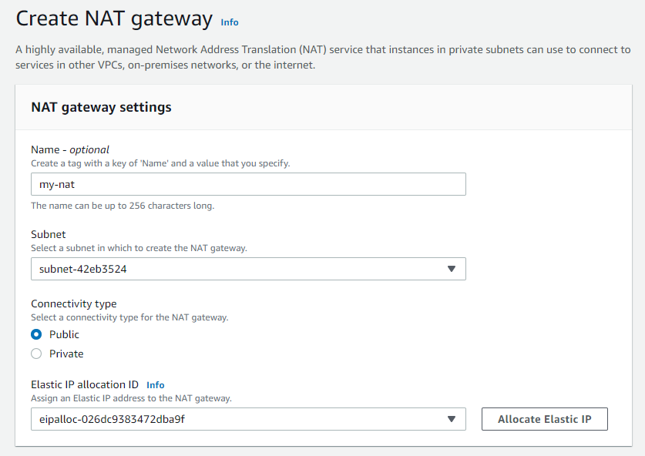
1. Create NAT Gateway
Fill in the name for reference
Attach to any public subnet
Set to public to allow outbound connection
Allocate elastic IP

Slide 55
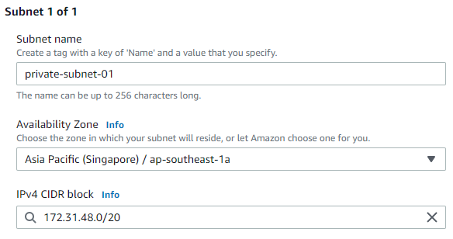
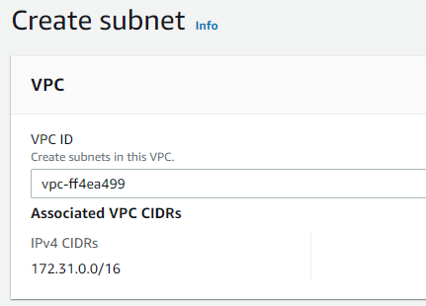
2. Create Private Subnet
Set the subnet name
Select availability zone
Select current VPC
Set IPv4 CIDR

Slide 56
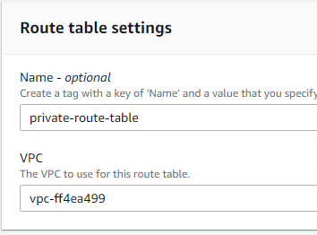
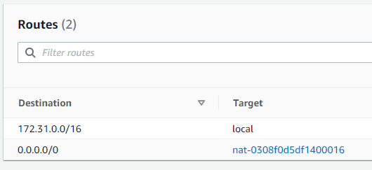
3. Create Private Route Table
Fill in the name and select VPC
Add NAT gateway to the table

Slide 57
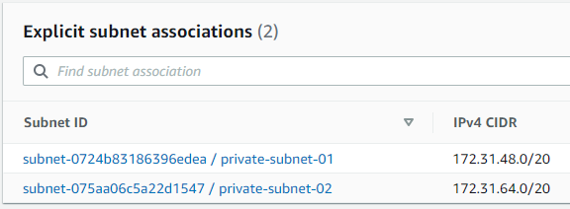
3. Create Private Route Table
Associate all private subnets to the route table

Slide 58
Now, let’s deploy to production !!
Auto Scaling with Higher Cost

Slide 59
Let’s design high level architecture first
VPC
Internet
Gateway
Public subnet
Private subnet
NAT Gateway
ECS Nginx
ECS
App
Internet Facing
Load Balancer
Internal Load Balancer
RDS

Slide 60
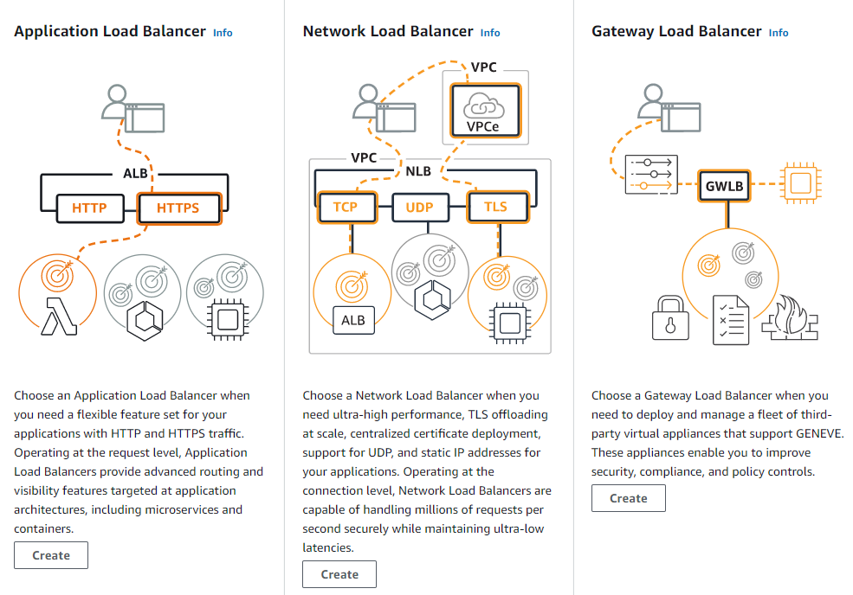
Prior to set up the ECS, we need to bring both internet facing and internal Load Balancer up first. Let’s do this
For both cases, since we are dealing with HTTP/s protocol, let use application load balancer

Slide 61
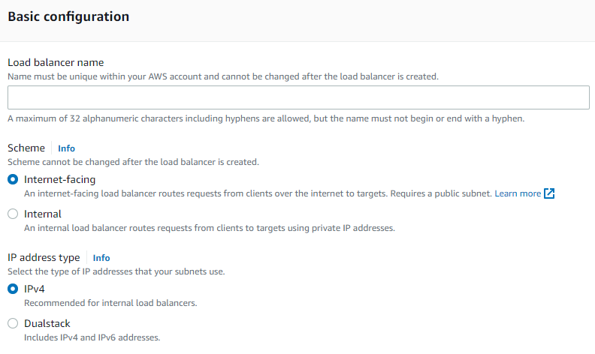
Configuration for the internet-facing load balancer
Set the load balancer name
Let’s choose internet-facing for this one
You decide, whether to support both IPv4 and IPv6

Slide 62
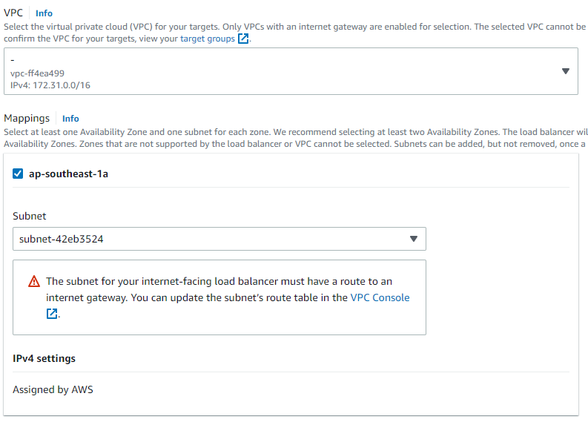
Configuration for the internet-facing load balancer
Select the same VPC
Make sure to select the public subnet since we want to allow the external access

Slide 63
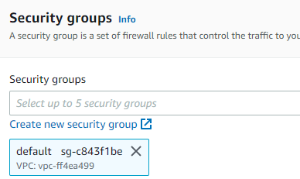
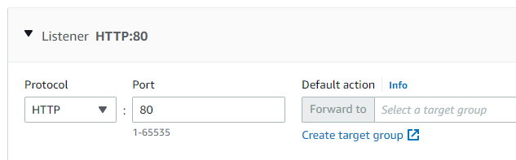
Configuration for the internet-facing load balancer
Set the right security groups
Click create target group

Slide 64
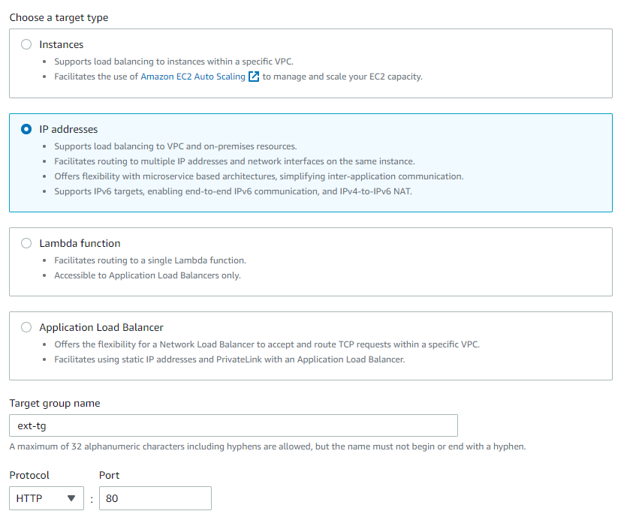

Create target group
Don’t change anything, just create target group
Select IP Address
Fill in the name and port

Slide 65

Configuration for the internet-facing load balancer
Back to the previous configuration page, click refresh, select the right target group

Slide 66

Configuration for the internal load balancer
All are the same except:
Select “Internal” instead of “Internet-facing”
Select “Private Subnet” instead of “Public Subnet”
Can you try ?

Slide 67
What is Elastic Container Service (ECS) ?
ECS is similar to Kubernetes whereby it intended to make an easy deployment, managing and scaling for the container such as Docker
Cluster
Task
Service A
Service B
Service C
Task Definitions
Fargate
EC2
Task A
Task C
Task D
Task B

Slide 68



Let’s create our first cluster
Select Networking only
Create the cluster
Fill in cluster name and Tags

Slide 69


Before we can create any service, we need to have our Task Definition
Enter name
Select FARGATE for serverless deployment
Select Linux

Slide 70


Before we can create any service, we need to have our Task Definition
Click add container to add docker container
Set minimum resources first

Slide 71

Add docker container at the Task Definition
Enter the container name
Copy the image url from ECR
Set the running Port

Slide 72

Add docker container at the Task Definition
Set health check command
Set the parameters

Slide 73


Now let’s create our first service and execute the task
Fill in all required fields
Select private subnet

Slide 74


Set the load balancer for the service
Set the port accordingly
Select ALB
Select LB name

Slide 75


Click Next until last page, then click Update Service
After a while, we should be able to see the task has be instantiated

Slide 76
Let’s reduce deployment cost in Production
Manual Scaling with Lower Cost

Slide 77
Then, let’s design a simple architecture
VPC
Internet
Gateway
Public subnet
Private subnet
Bastion Server
EC2
Load Balancer
NAT Gateway
RDS

Slide 78
Thank you.

